Slide 1
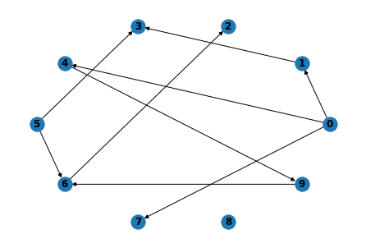
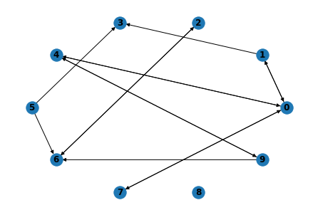
10 nodes
True:
PC
PC reverse + PC
Time:
Time: 0.05830502510070801

Slide 2
20 nodes
True:
PC
PC reverse + PC
Time:
Time: 0.25998544692993164

Slide 3
30 nodes
True:
PC
PC reverse + PC
Time:
Time: 6.734421491622925

Slide 4
40 nodes
True:
PC
PC reverse + PC
Time:
Time:50.83748698234558

Slide 5
50 nodes
True:
PC
PC reverse + PC
Time:
Time:

Slide 6
60 nodes
True:
PC
PC reverse + PC
Time:
Time:

Slide 7
70 nodes
True:
PC
PC reverse + PC
Time:
Time:

Slide 8
80 nodes
True:
PC
PC reverse + PC
Time:
Time:

Slide 9
90 nodes
True:
PC
PC reverse + PC
Time:
Time:

Slide 10
100 nodes
True:
PC
PC reverse + PC
Time:
Time:

Slide 11
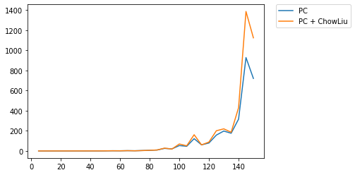
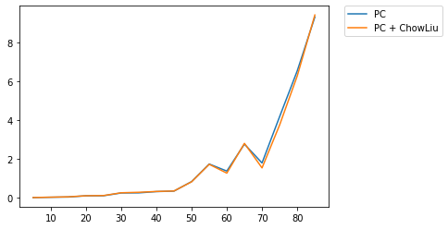
PC+ChowLiu V.S. PC
Density: 0.05
Zoom-in

Slide 12
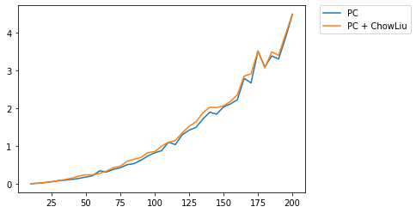
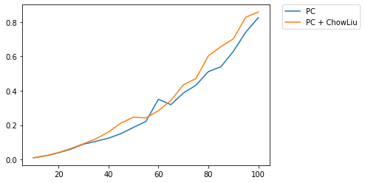
PC+ChowLiu V.S. PC
Density: 0.01
Zoom-in

Slide 13
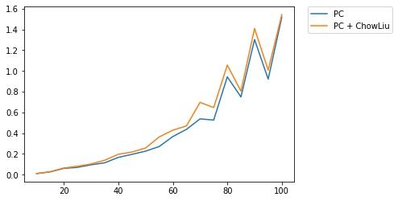
PC+ChowLiu V.S. PC
Density: 0.02

